Slide 1
Special Topics in Deep Learning for Big Data, Professor Kim Taejong, Hanyang University
Development of a Convolutional-Neural-Network
for the Classification of Covid-19 X-Ray Images
by
Nguyen Peter Phan Dinh
09/06/2021

Slide 2
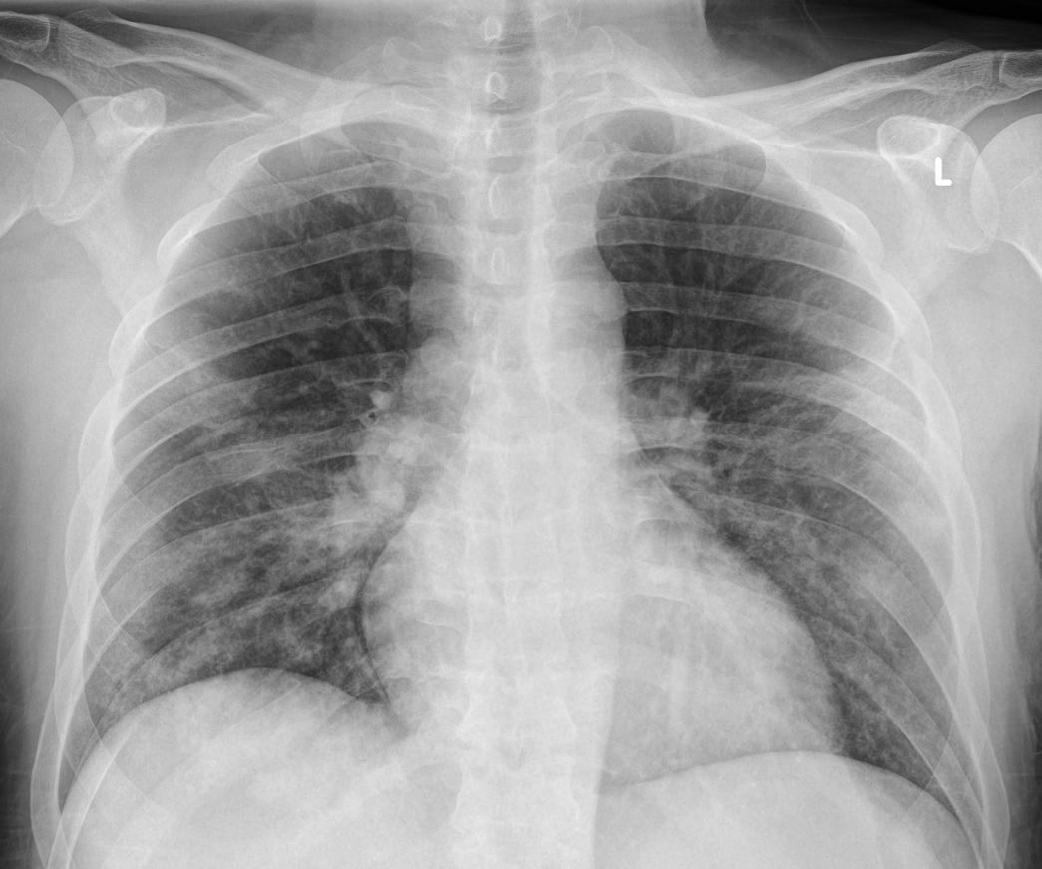
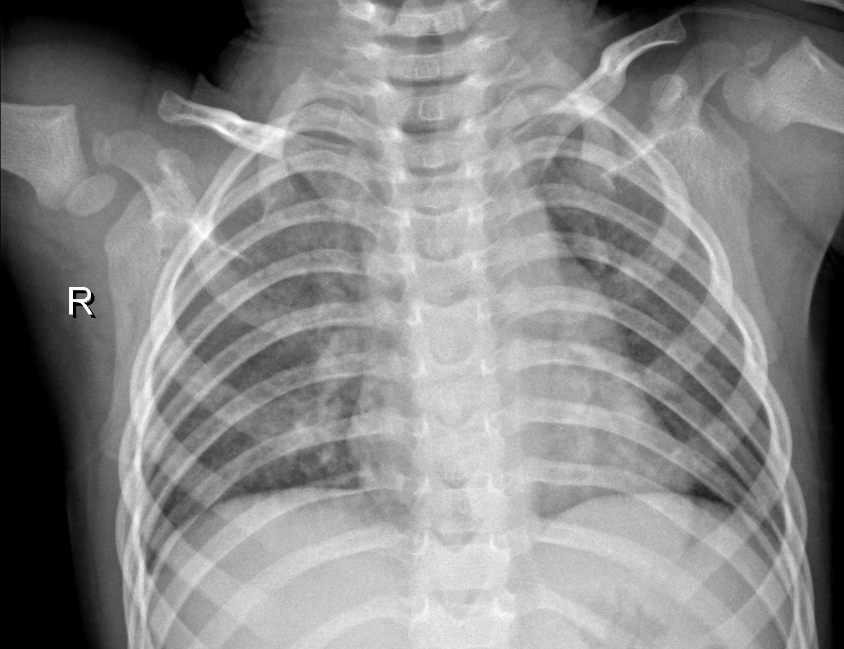
Motivation and Goal
Negative
Positive
[1]
[2]
Motivation
Interpretation of X-rays can be time consuming and error-prone.
Speed up the process and increase the accuracy of the detection to improve the diagnosis of COVID-19.
Goal
Developing a Convolutional Neural Network (CNN) to classify X-rays for the determination of COVID-19 cases.

Slide 3
Dataset
Datesets of X-ray images
Covid-19-negative (normal): https://www.kaggle.com/paultimothymooney/chest-xray-pneumonia [1]
Covid-19-positive: https://github.com/ieee8023/covid-chestxray-dataset [2]
Data filtering
Dataset in github contains X-ray images of several infections (COVID-19, Streptococcus, Influenza,etc.).
Filter data for only COVID-19 X-rays.
Dataset contains x-rays with different views (PA = Posteroanterior and AP= Anteroposterior).
Filter data for only PA-view.
To avoid the development of a bias in the model, the ratio of positve/negative data is set to 1.
Dataset workflow
All data
196 samples of positive data + 196 samples of negative data = 392 samples of data.
All training data
Test data
70% as training data and 30% as test data.
3
To train model
Validation
15% of all training data as validation data.

Slide 4
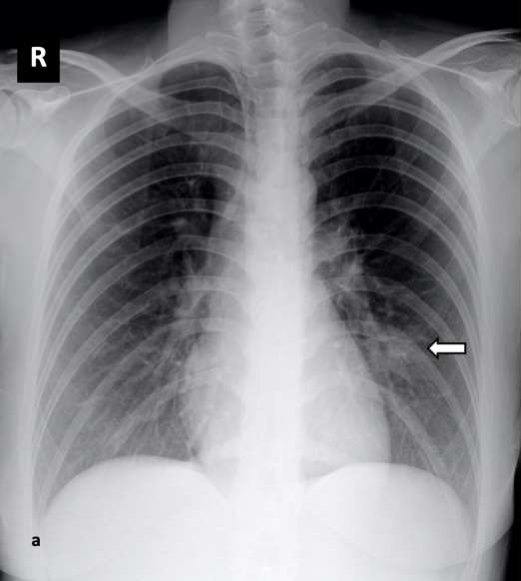
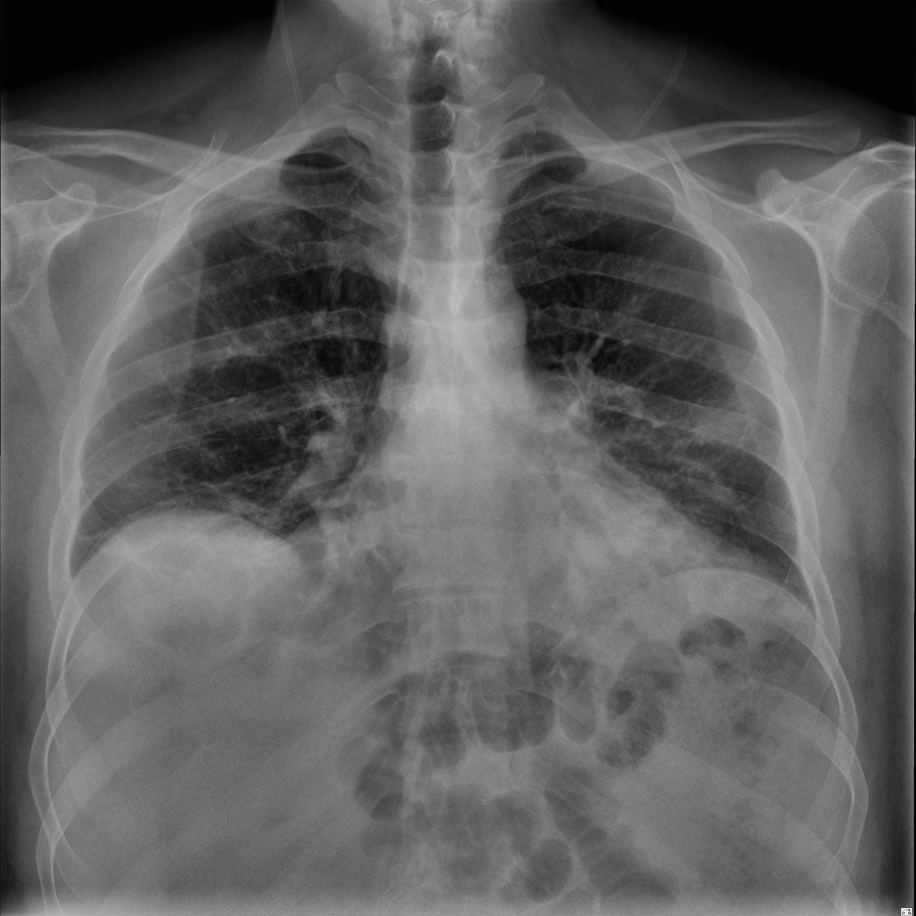
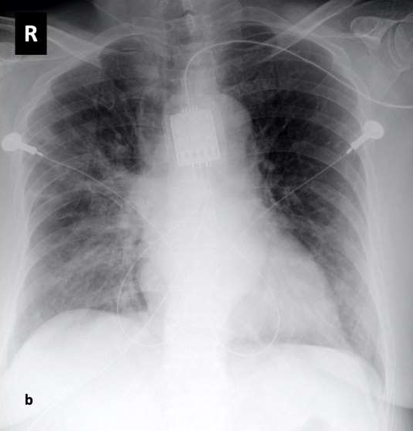
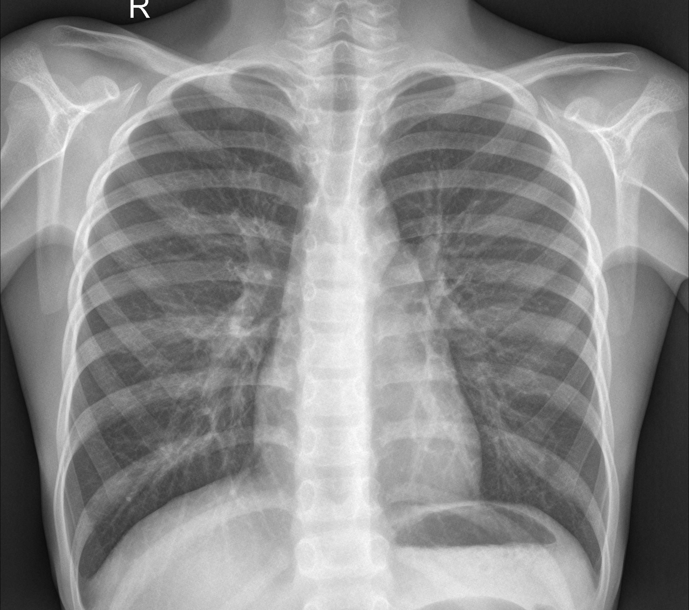
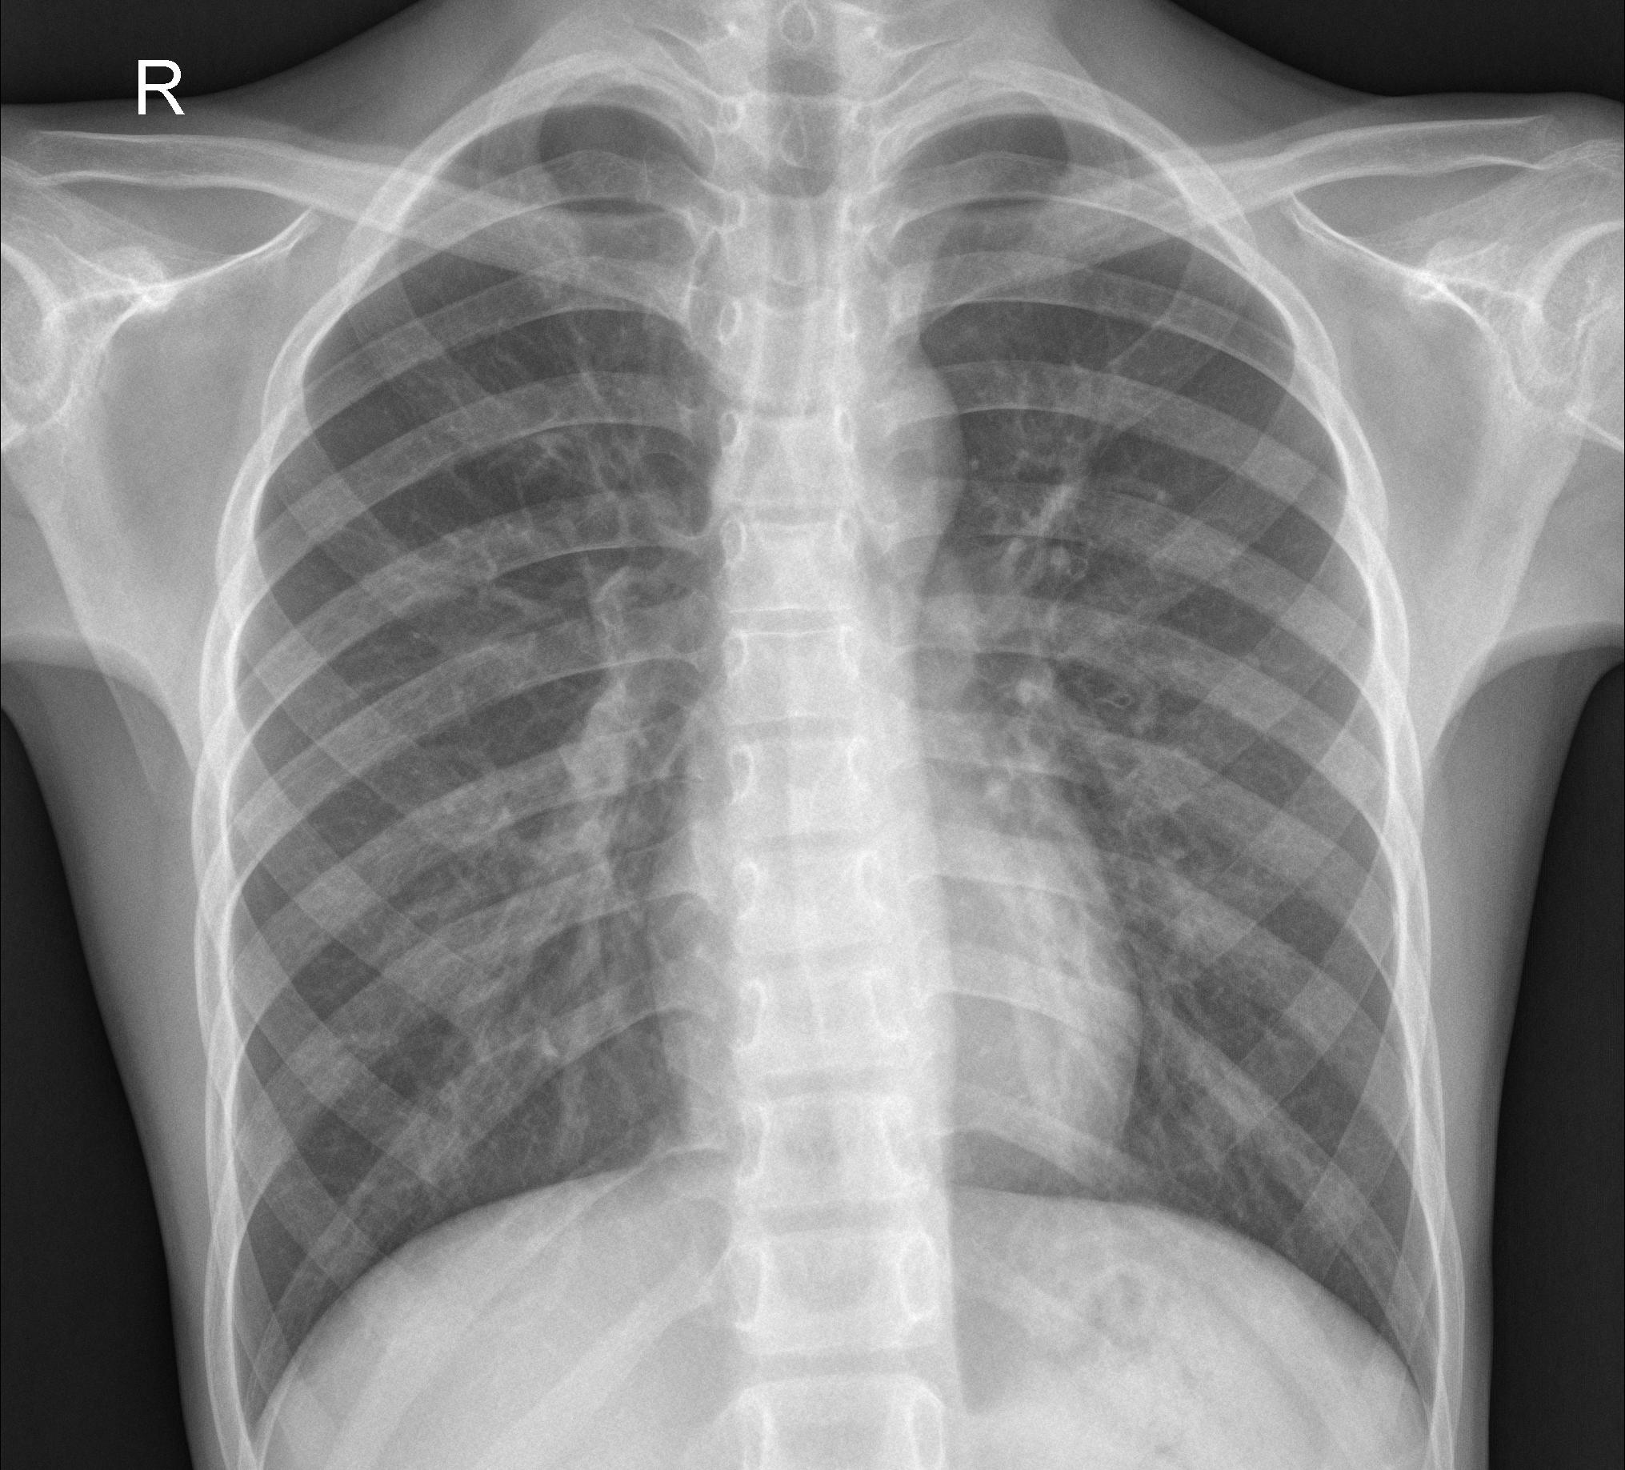
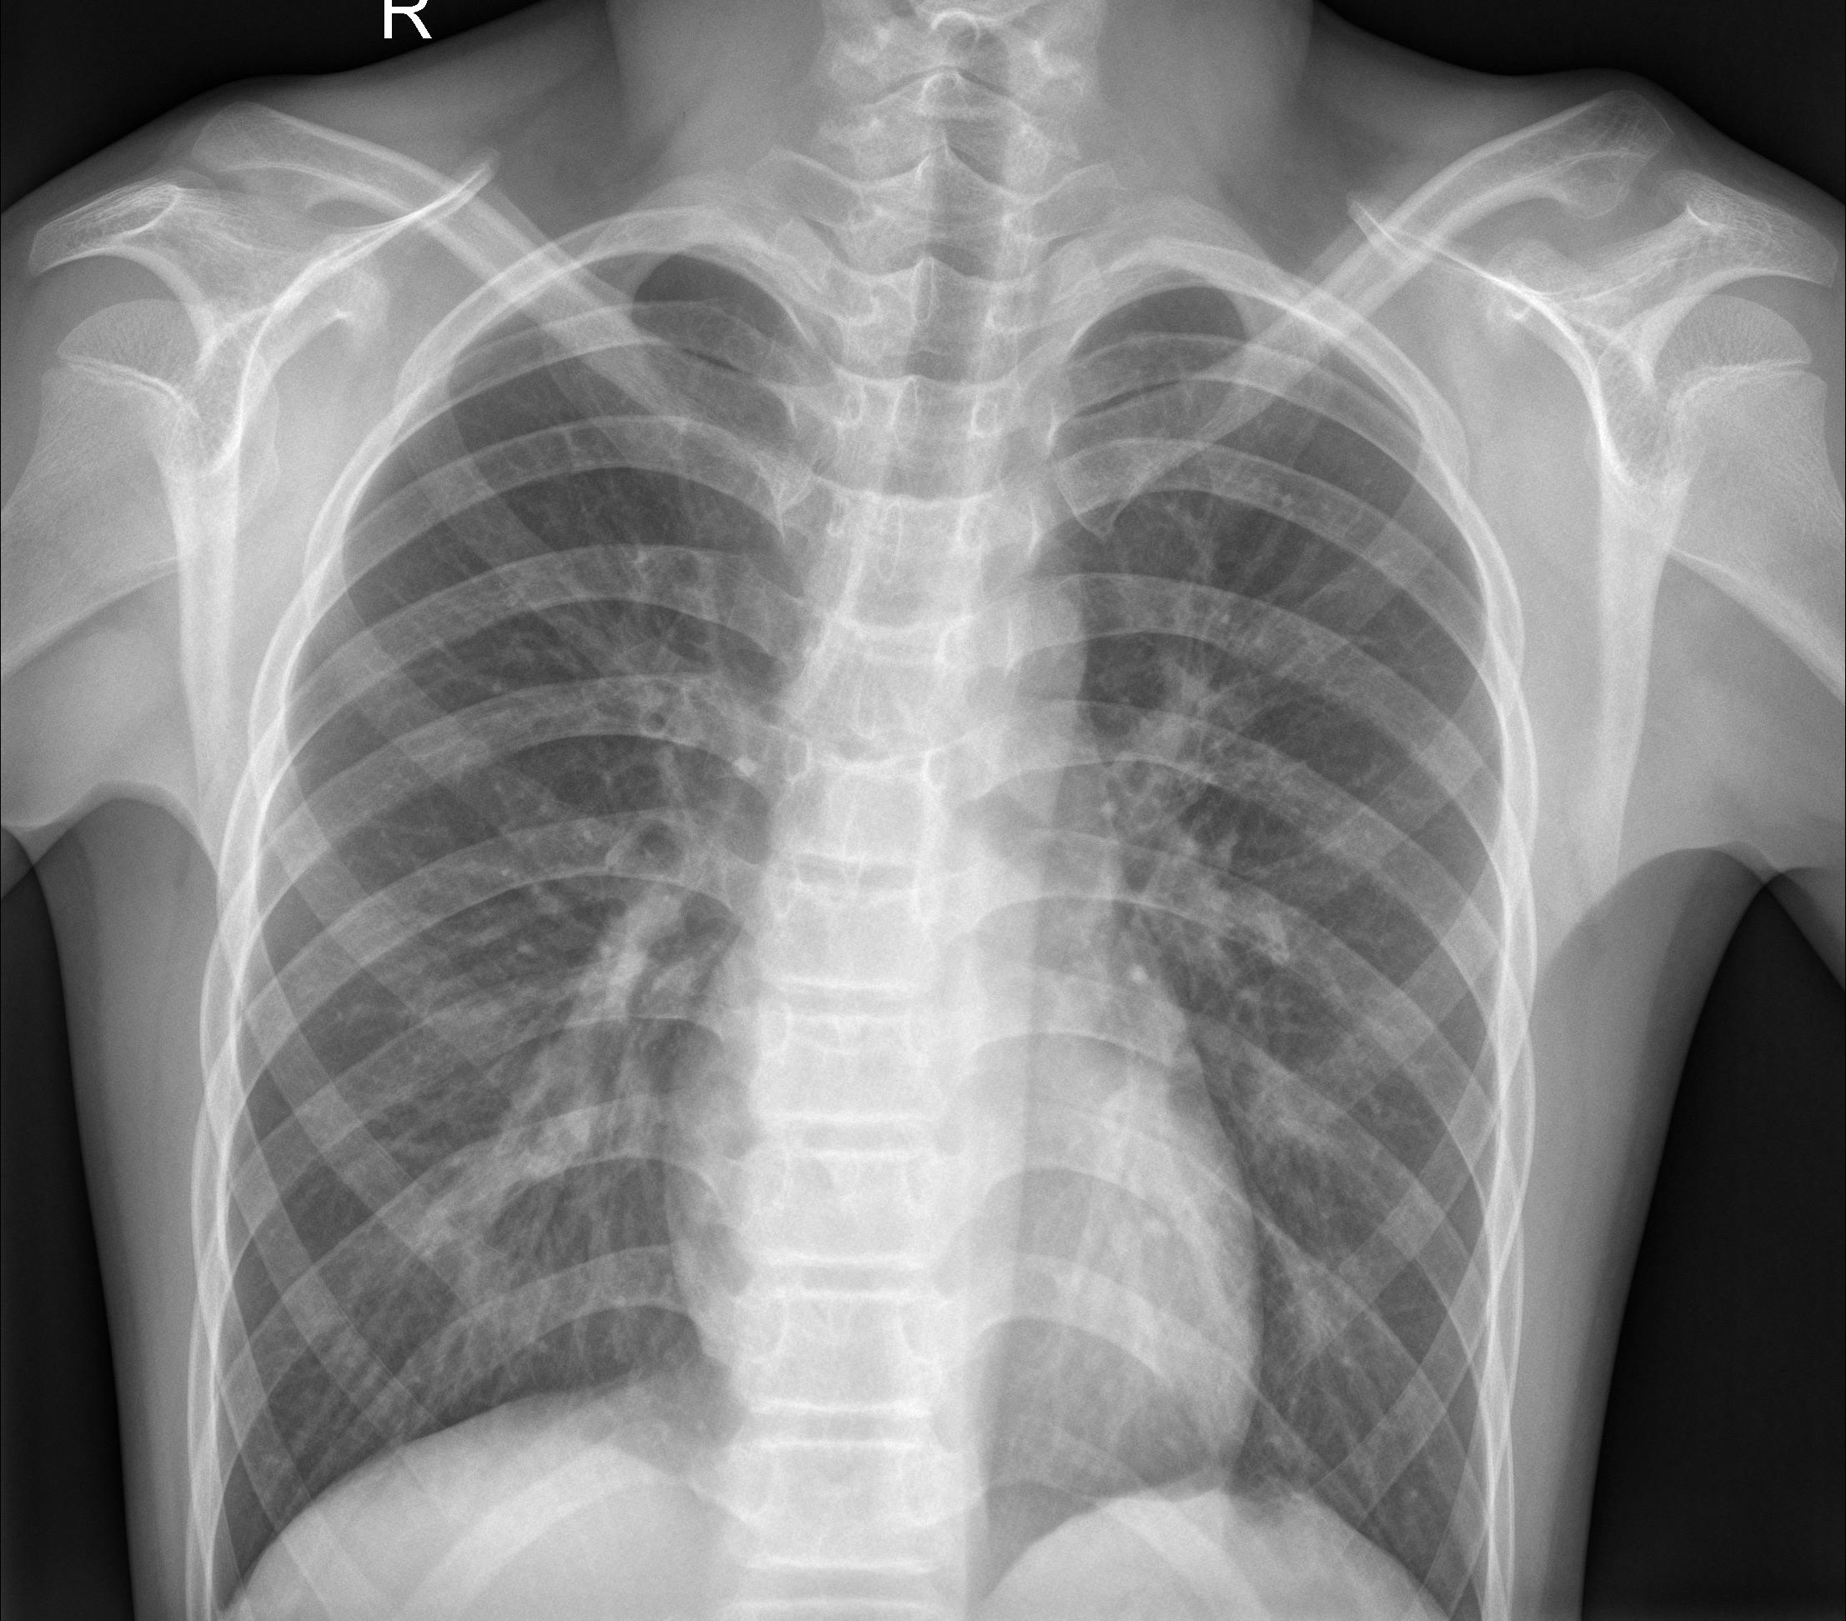
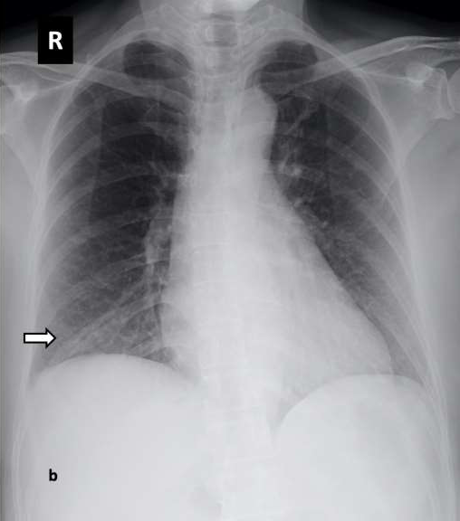
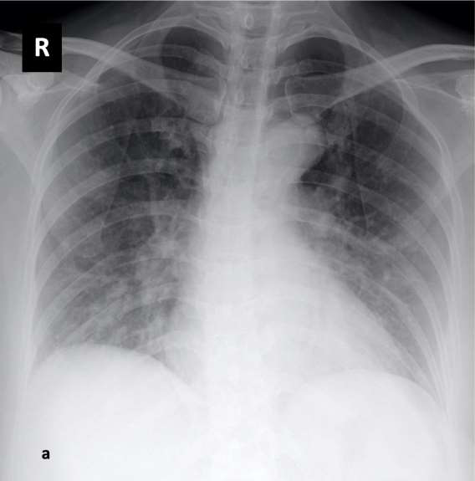
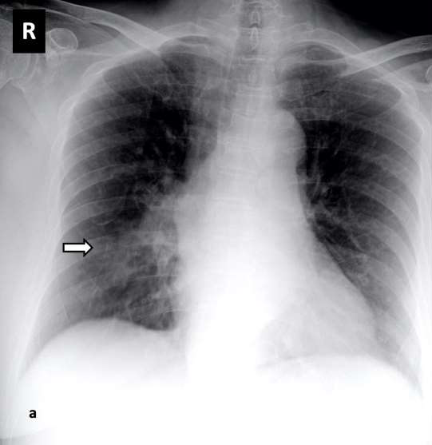
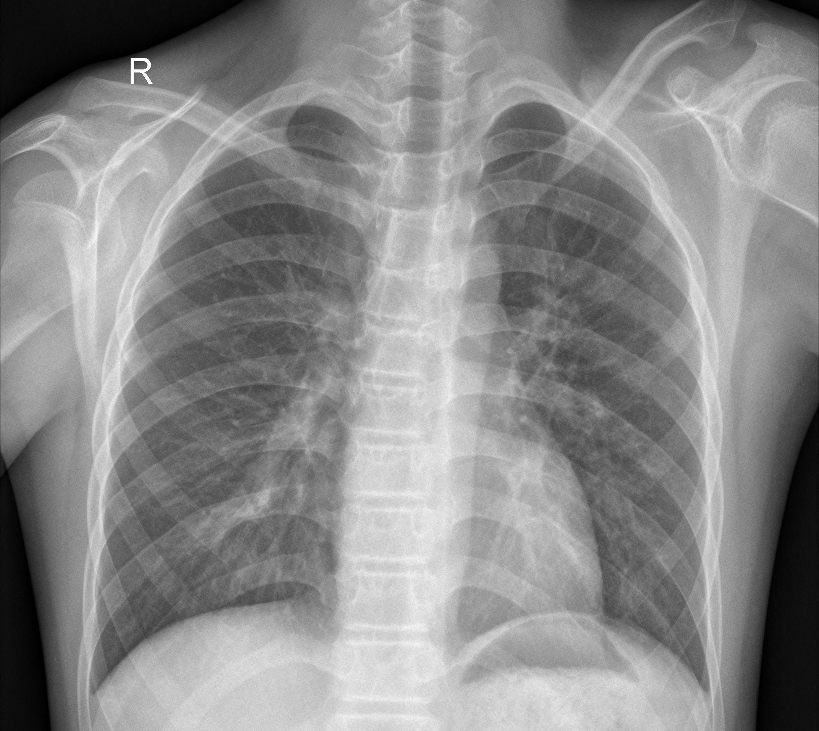
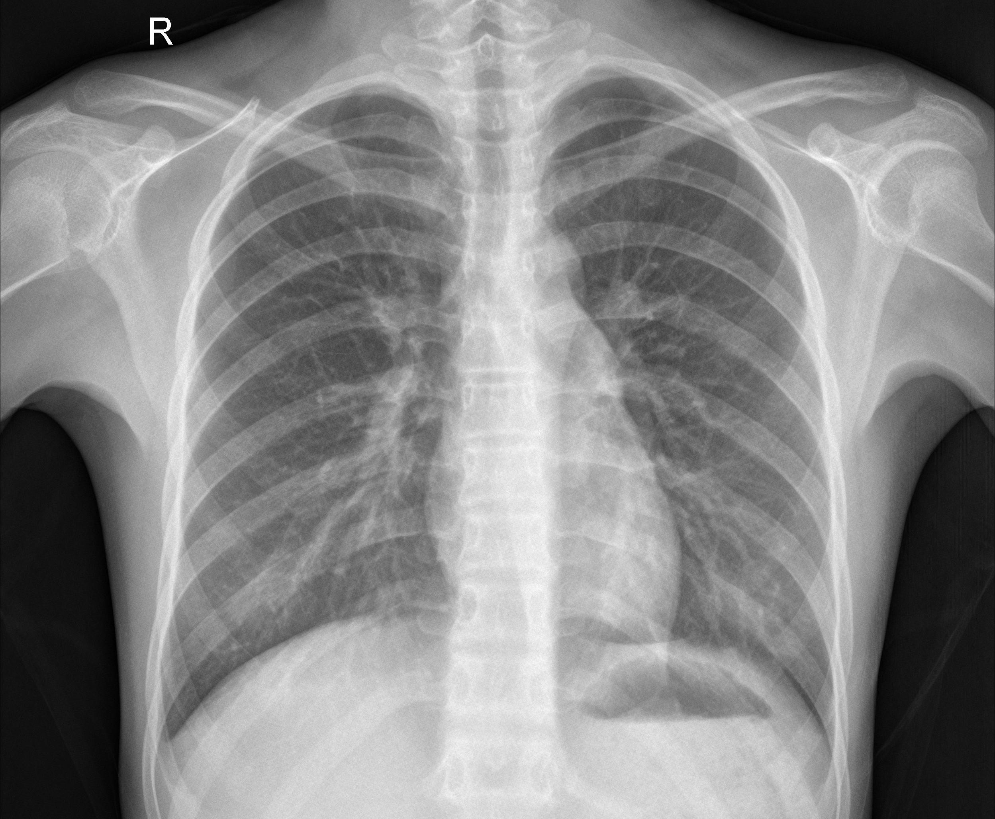
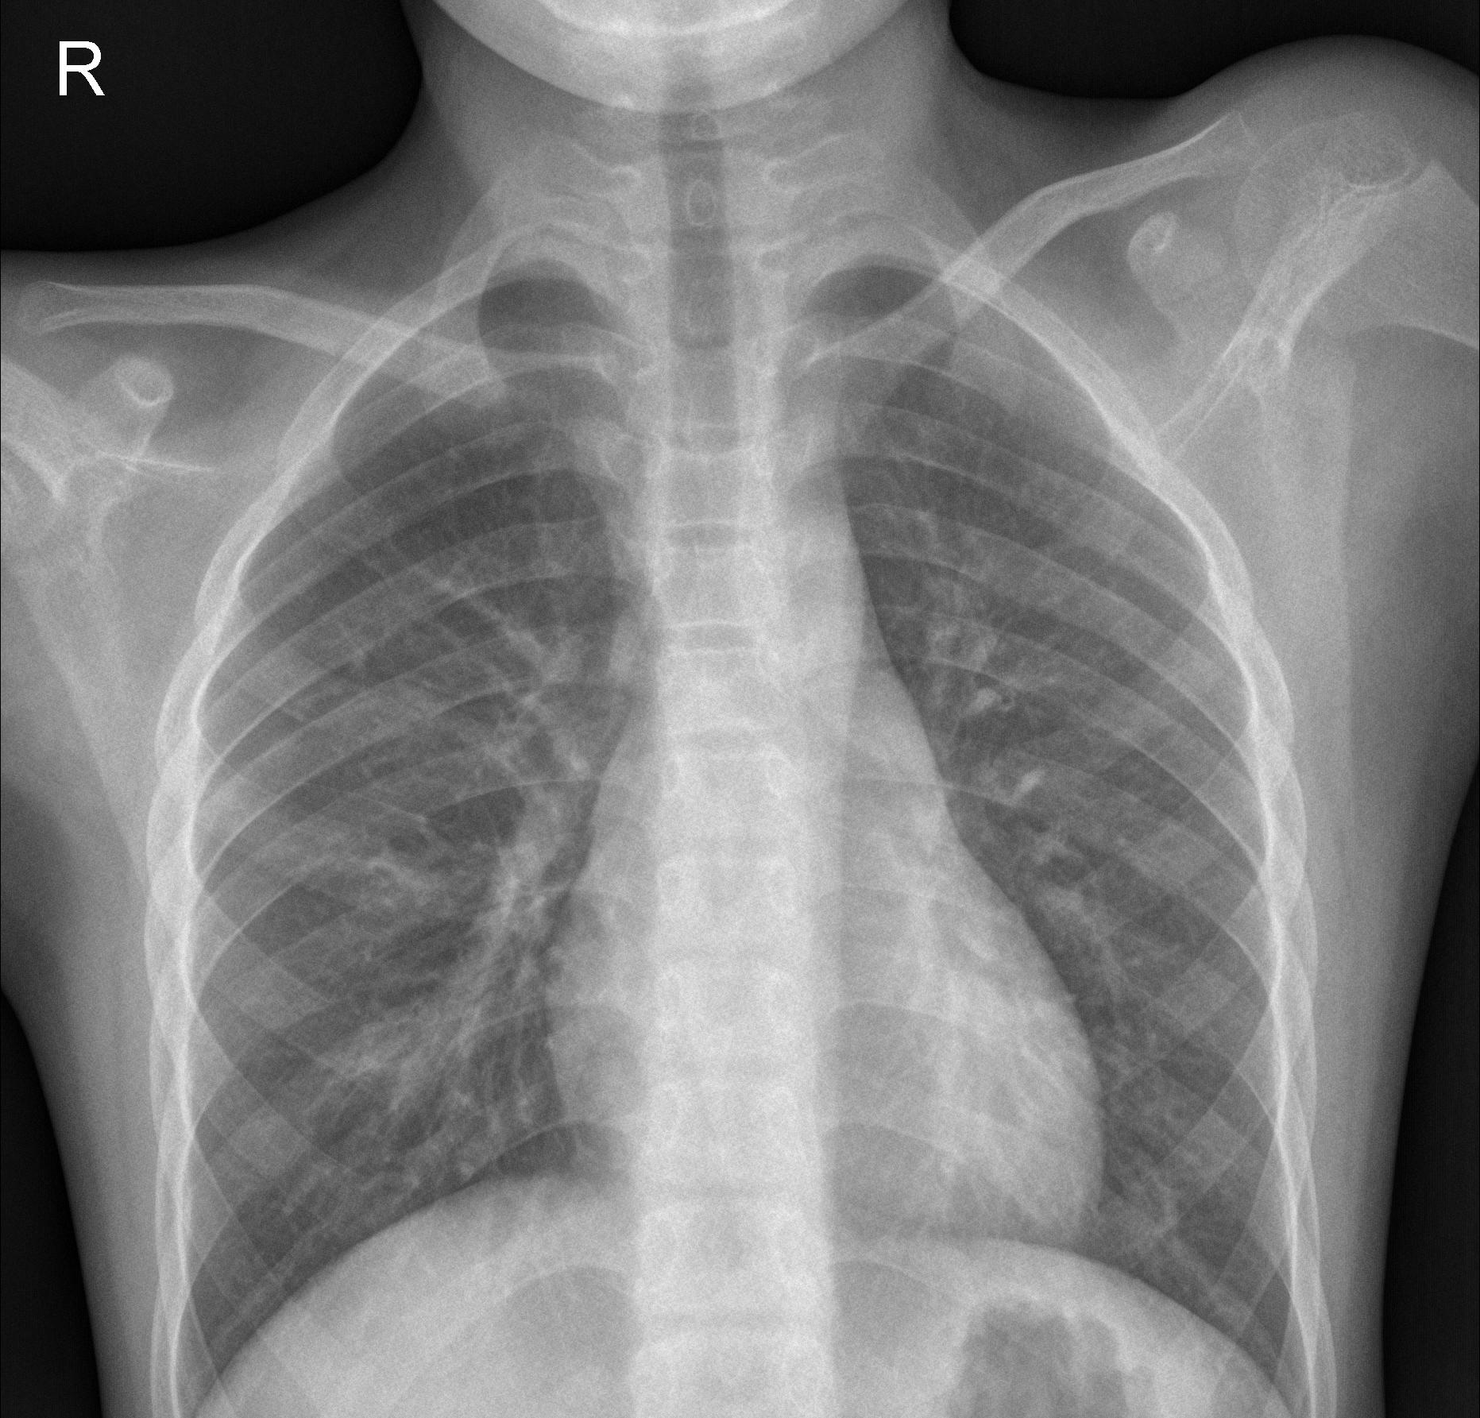
Dataset
A sample from the dataset
COVID-19-positive X-rays
COVID-19-negative X-rays
Next step: train a CNN to learn the patterns (features) of the COVID-19-positve X-rays.

Slide 5
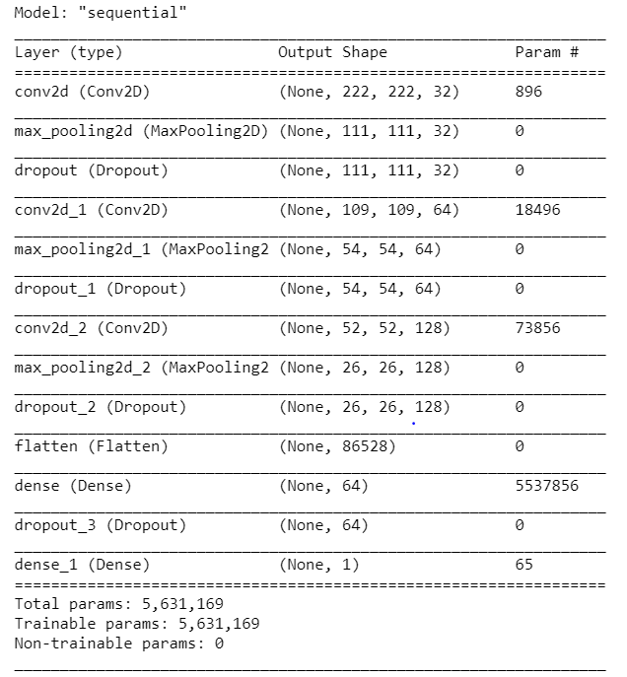
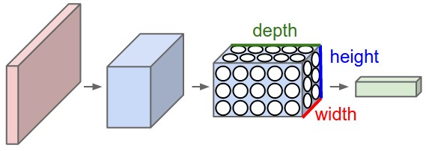
CNN-Model Development
CNN-Model Development
Convolutional Neural Network
[3]
CNN model is defined by using the Python-library Keras [4].
Model parameters such as filters, kernel size, dropout rate, etc. are set.
15% of the training data is used for validation and updating the hyperparameters during the training process.
ReLu is used as the activation function throughout the CNN.
In total, 5,631,169 parameters are trained.

Slide 6
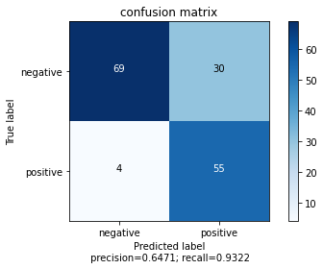
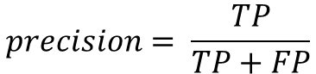
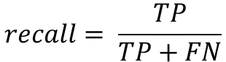
CNN-Model Development
The developed model is applied on the test data and the result is illustrated in a confusion matrix.
In this classification task, accuracy is not a suitable measure.
Example: For 100 x-rays (with 10 COVID-19-positive cases), the model always predicts negative.→ accuracy=90% but it fails to predict the positive cases.
Instead, the measures precision and recall are used [5].
$$precision= \frac{TP}{TP+FP}$$
TP = True positives
FP = False positives
FN = False negatives
$$recall= \frac{TP}{TP+FN}$$
Equations to compute the model performance
Accuracy = 0.785
With current model, out of 100 COVID-19-positive cases, 7 cases will be missed.
For medical applications not acceptable.
Next step: Improving model‘s precision and recall by tuning the hyperparameters.

Slide 7
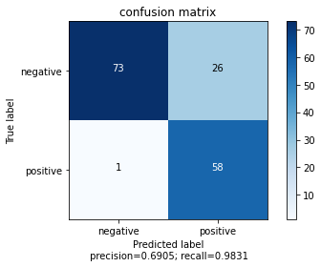
CNN-Model Development
Improve the model performance by tuning the Hyperparameters
Using the Python-library Keras Tuner, different combinations of hyperparameters are tested [6]:
filter dense_layer = [64, 128], dropout_rate = [0.2, 0.3, 0.4, 0.5], learning_rate = [0.0001, 0.001, 0.01] .
In total, 50 different hyperparameter-combinations are tested and the best model is picked from the output.
Precision is increased from 0.65 to 0.69 and recall is increased from 0.93 to 0.98.
With the improved model, out of 100 COVID-19-positive cases, 2 cases will be missed.
However, the number of false negatives is still high.
Accuracy = 0.83

Slide 8
Summary and Outlook
Summary
A CNN has been developed to classify X-rays in order to detect an infection with COVID-19.
The CNN is developed using Keras and its hyperparameters are tuned with Keras Tuner.
Through hyperparameter tuning, the number of false negative identifications is reduced from 7 to 2 per 100 COVID-19-positve samples.
However, the developed model is not perfect and should only serve as a support for the radiologist in classifying COVID-19-patients.
Outlook
Further optimization of the hyperparameters by widening the search space.
Usage of more data in the training process.

Slide 9
References
[1] https://www.kaggle.com/paultimothymooney/chest-xray-pneumonia
[2] https://github.com/ieee8023/covid-chestxray-dataset
[3] https://cs231n.github.io/convolutional-networks/
[4] https://keras.io/getting_started/
[5] https://scikit-learn.org/stable/auto_examples/model_selection/plot_precision_recall.html
[6] https://keras-team.github.io/keras-tuner/
More information about the usage of CNN in COVID-19 X-ray classification can be found in the paper: https://www.medrxiv.org/content/10.1101/2020.08.20.20178913v2.full.pdf

Slide 10
Thank you for your attention!

